Slide 1
Belarusian State University
Prepared by Pavel Zhukovski (13 group)

Slide 2
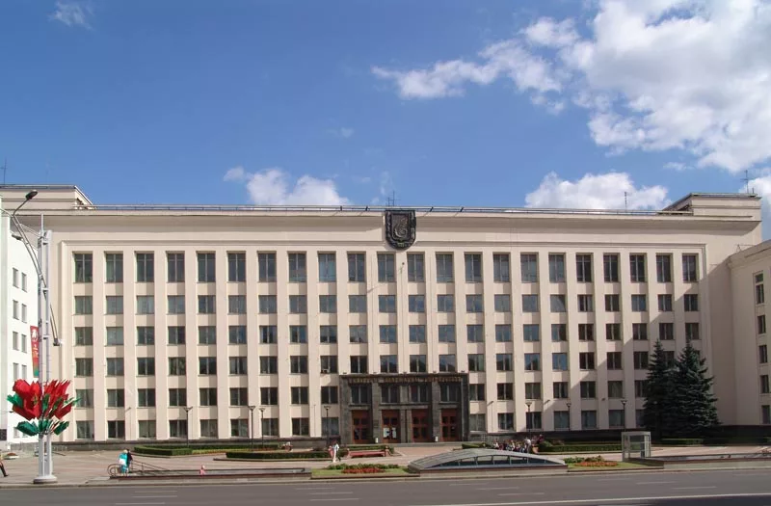
The Belarusian State University:
was founded on October 30, 1921
is a leading scientific, educational, innovation and cultural centre of the Republic of Belarus
is based on creative cooperation of academic staff and students

Slide 3
Main aims of BSU:
performing educational, research and innovation programs
forming an auspicious conditions for development of intellectual and creative potential of individual
cherishing and upholding the best traditions of university classic education
securing a fitting place in the world educational area

Slide 4

Traditions and technologies (film)

Slide 5

Some other facts and figures (film)

Slide 6
Thanks for watching!

